Slide 1
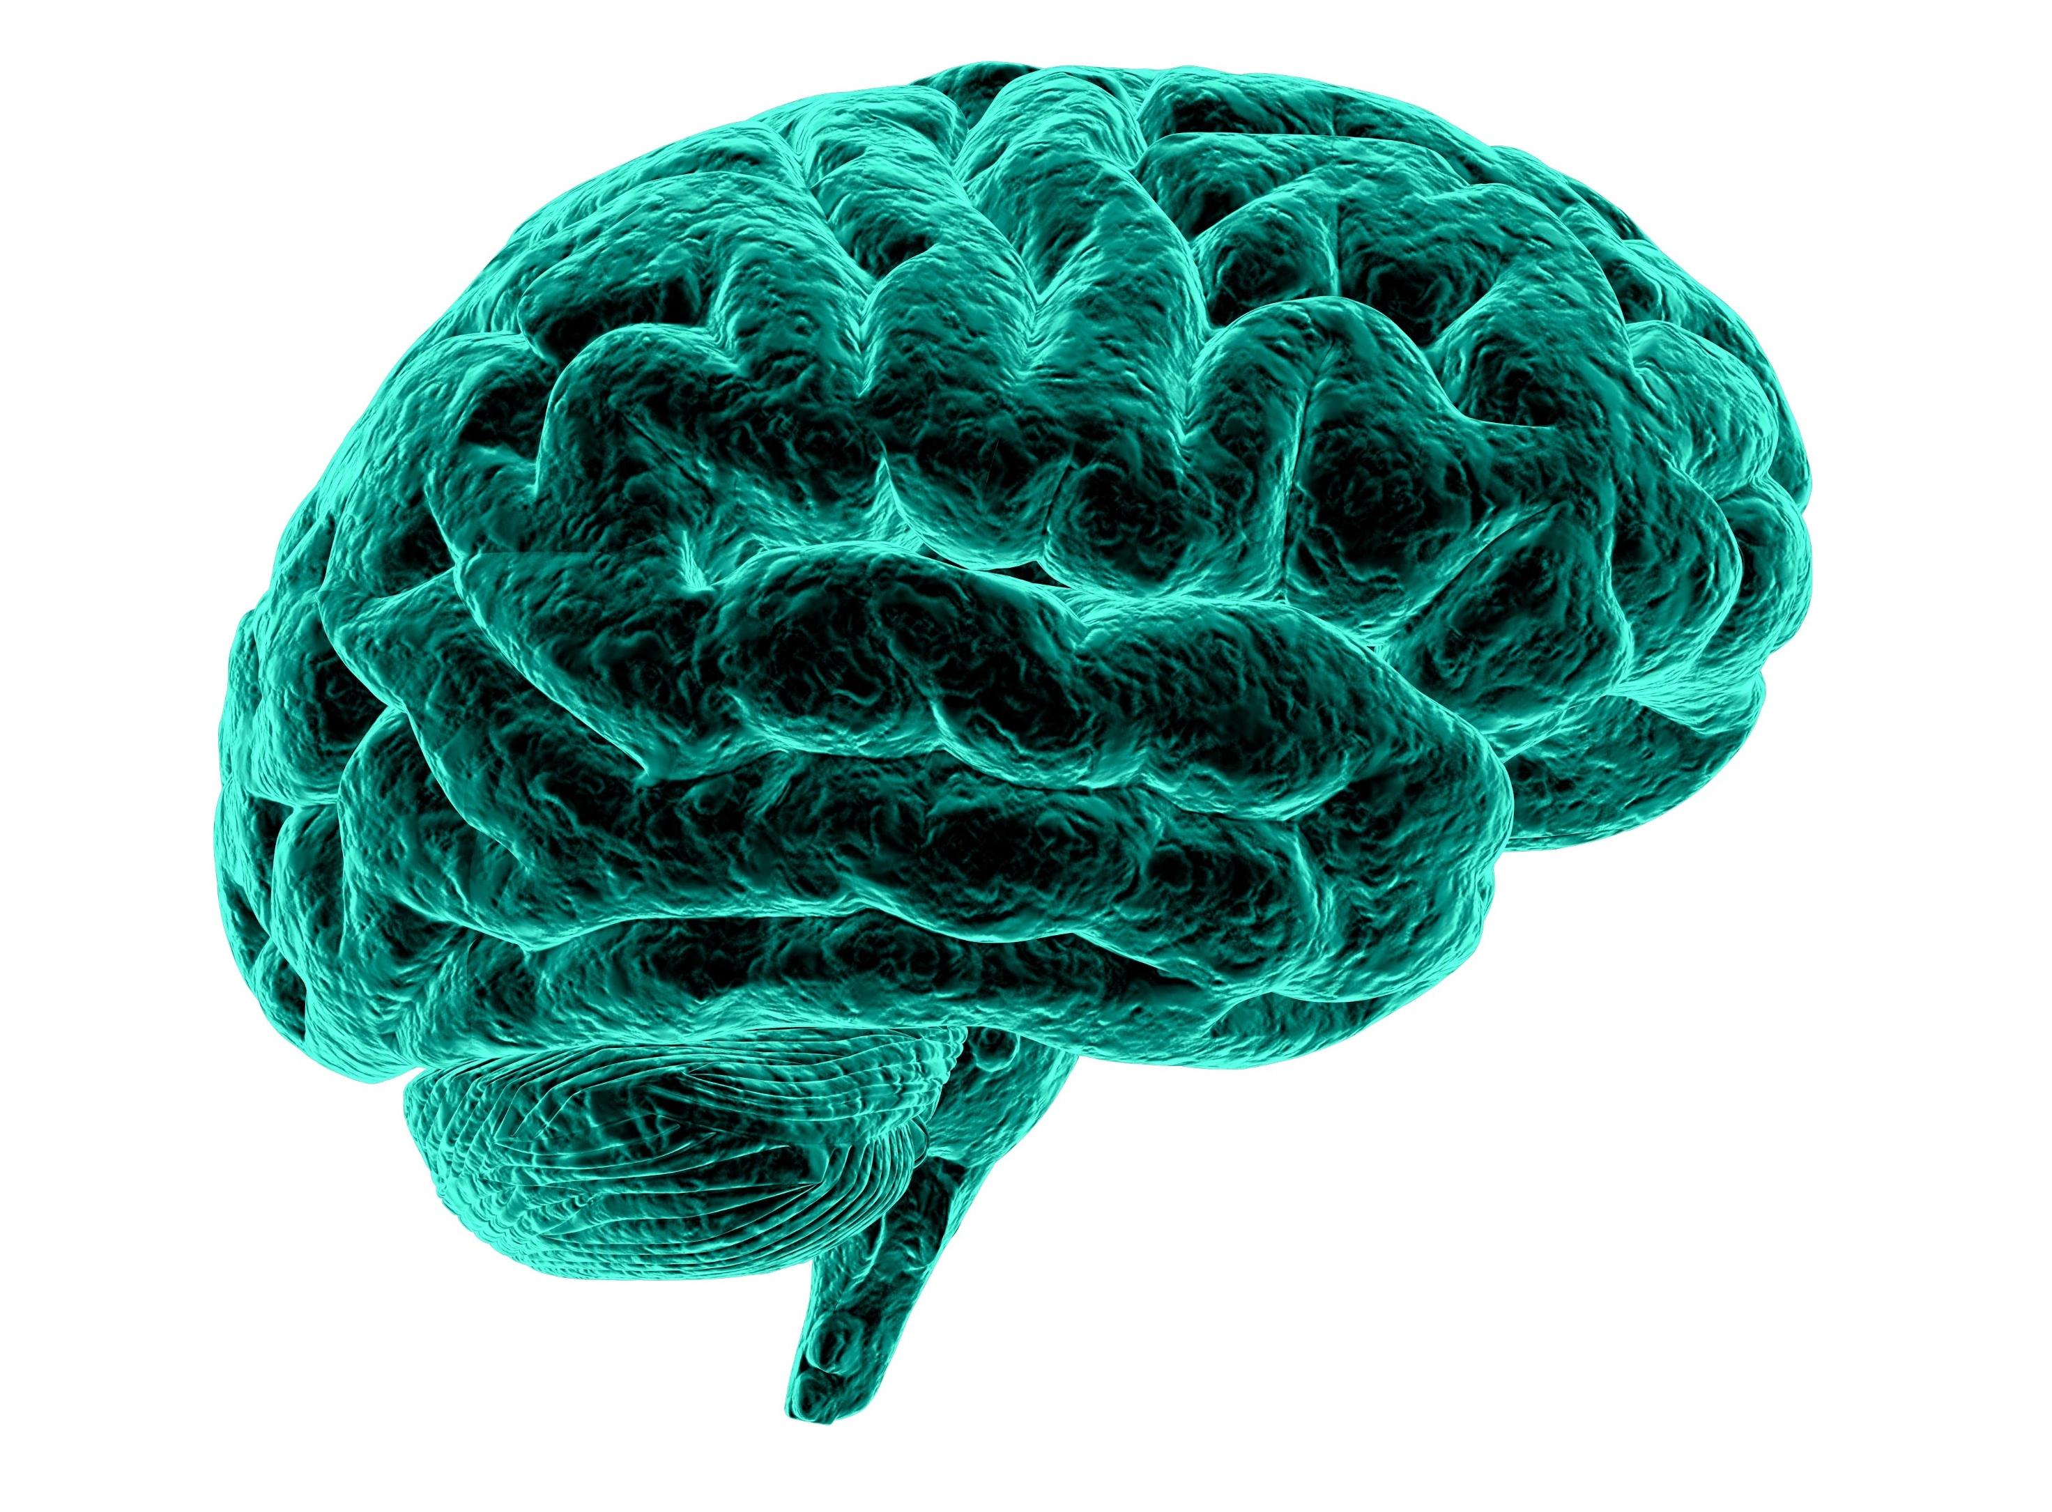
NeuroX Hybrid: Advanced Brain Analysis Platform
Review I – Problem Identification, Domain Analysis & Feasibility Study
Project ID/Code: BCSE498J
Team Members:
Munta Sai Karthik – 22BCE5060
Gotam Sai Varshith – 22BCE1605
Manideep Sandireddy – 22BCE1434
Guide: Dr. Jayaram B
Department: Computer Science and Engineering

Slide 2
Project Abstract
The Goal: To design an automated "Hybrid" Deep Learning system for the simultaneous segmentation and classification of brain tumors from 3D MRI scans.
The Problem: Manual MRI analysis is slow (1-3 hours/patient) and prone to human error. Standard AI models often fail to capture the "global context" of the brain.
The Solution: A unified framework combining 3D ResNets (for detail) and Swin Transformers (for context).
Outcome: A web-based dashboard delivering 3D interactive visualizations and AI-generated clinical reports.

Slide 3
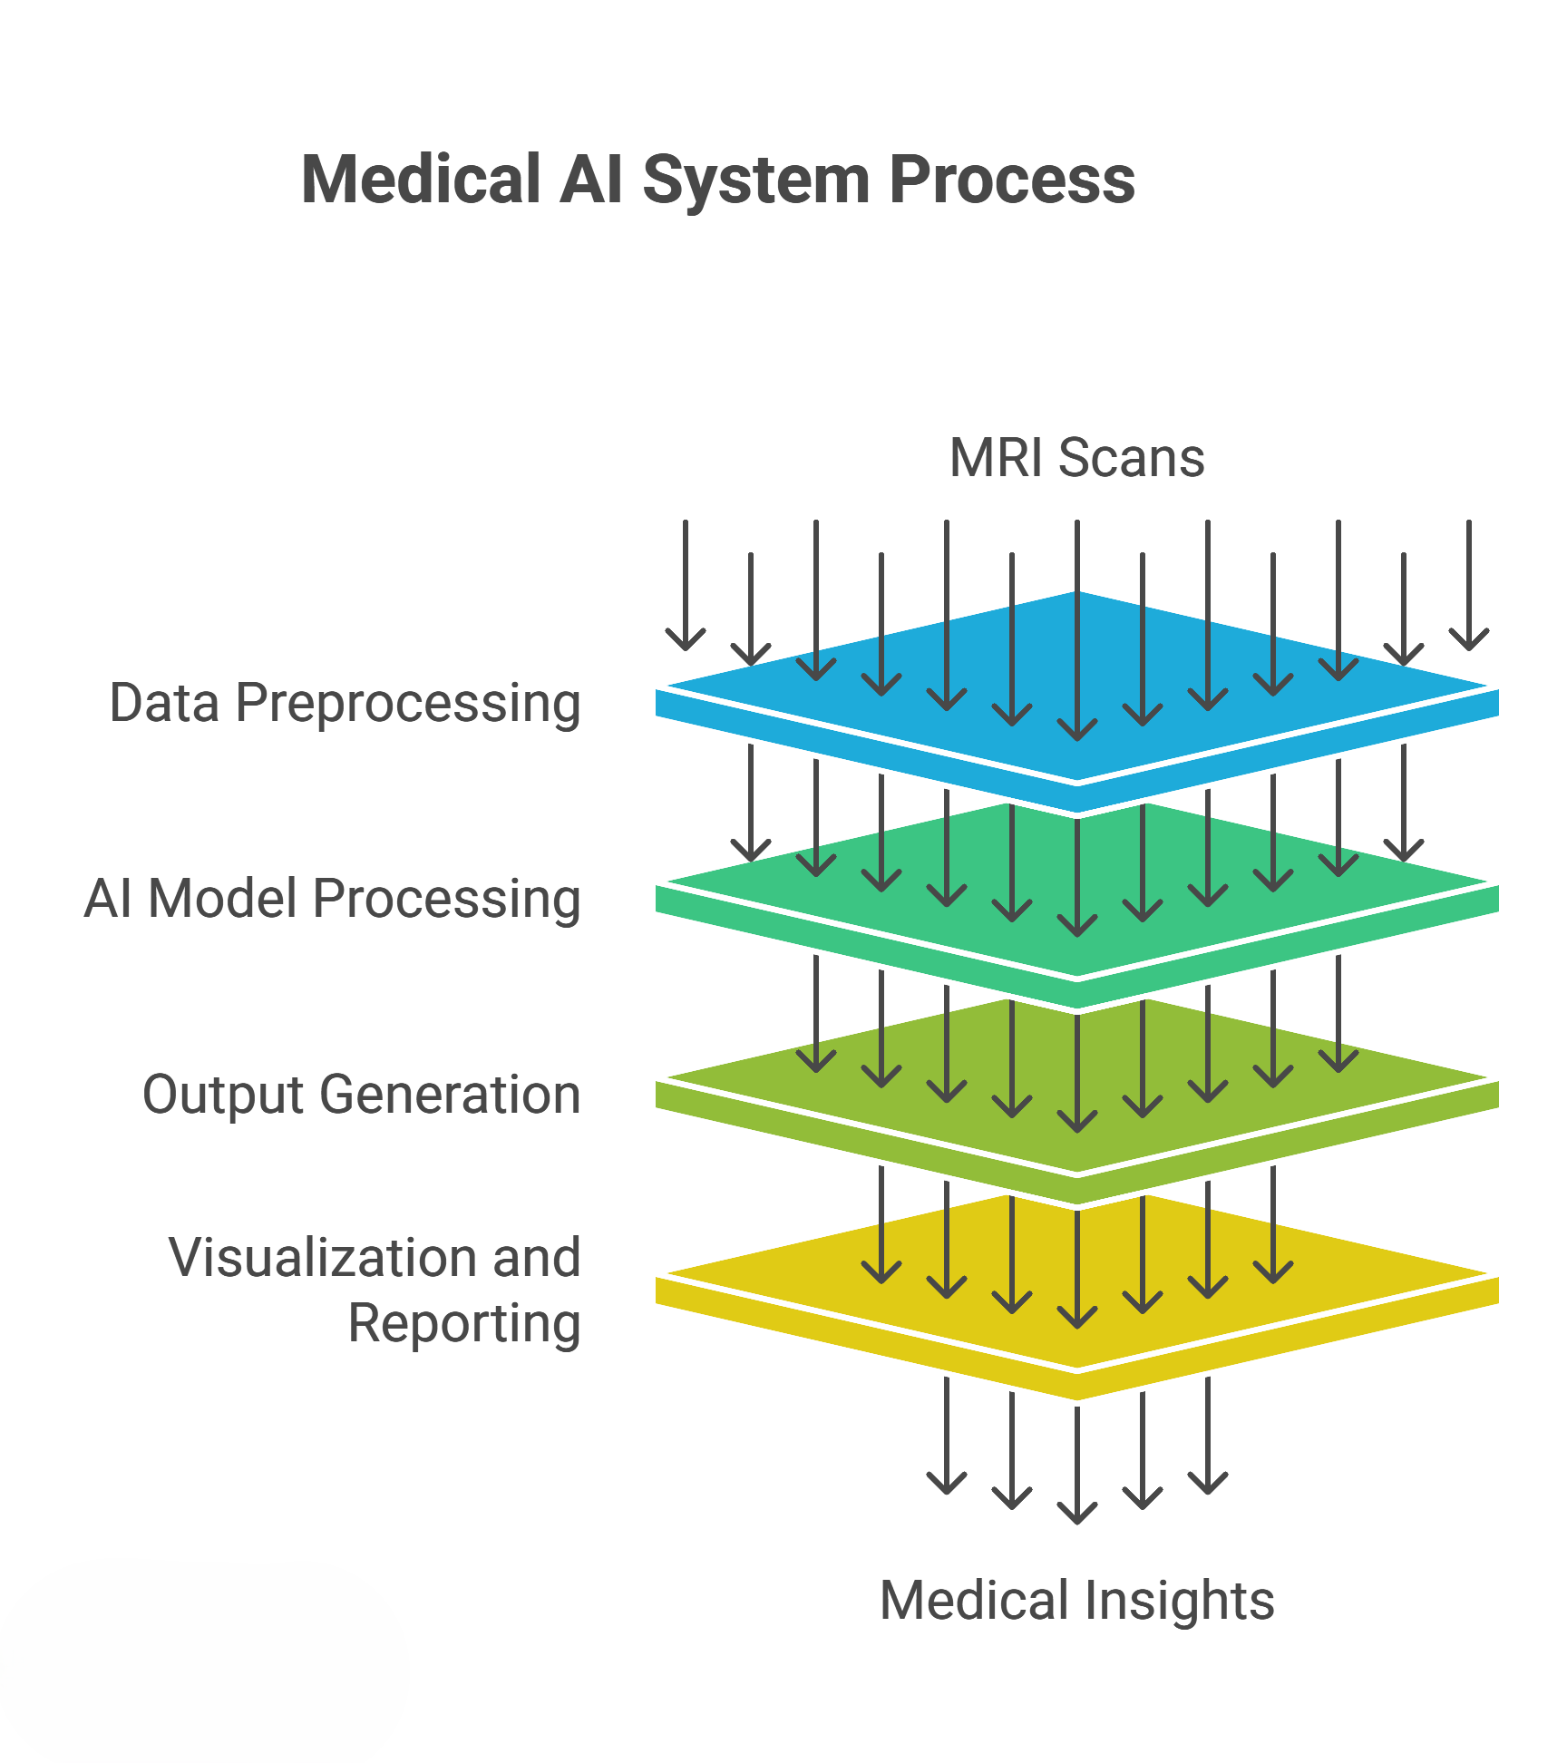
High-Level System Concept
Input: Raw Multi-Modal MRI data (NIfTI format).
Processing Layers:
The image demonstrates our layered approach:
Data Preprocessing → AI Model Inference → Output Generation.
Output: The system transforms raw pixels into "Medical Insights" (Reports & 3D Models).

Slide 4
Domain Identification (Rubric: Domain)
Primary Domain: Medical Computer Vision.
Sub-Domain: Volumetric (3D) Image Segmentation.
Clinical Context:
Neuroradiology: We are addressing the diagnosis of Gliomas and Meningiomas.
Multi-Modal Data: The domain requires analyzing 4 MRI sequences (T1, T1ce, T2, FLAIR) simultaneously to distinguish edema from the tumor core.
Relevance: Accurate segmentation is critical for radiotherapy planning and tracking tumor growth.

Slide 5
Problem Identification (Rubric: Problem ID)
Bottleneck: Radiologists face "Reader Fatigue." Manual segmentation is subjective; two doctors may trace the same tumor differently.
The "Context" Problem:
Tumors have irregular shapes and fuzzy boundaries.
Class Imbalance: Healthy brain tissue vastly outnumbers tumor pixels, making it hard for standard models to find small lesions.
Technical Gap: Existing tools are either fast but inaccurate (2D slices) or accurate but computationally impossible (Pure 3D Transformers).

Slide 6
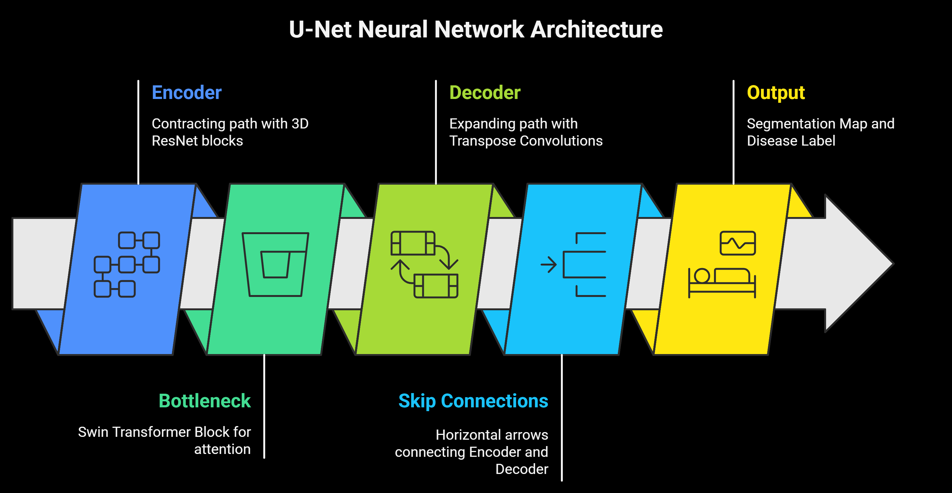
Background – The Standard Approach
This image shows the U-Net architecture, the current industry standard.
Strengths: Good at local feature extraction (edges/textures) using the "Encoder-Decoder" structure.
Weakness: It lacks "Global Attention." It sees the tumor's edge but struggles to understand where the tumor is relative to the rest of the brain structure.

Slide 7

Motivation for "Hybrid" Architecture
Why Hybrid? We propose combining the best of two worlds:
CNN (ResNet): Excellent at capturing high-frequency details (boundaries, texture).
Transformer (Swin): Excellent at capturing long-range dependencies (relationships between distant pixels).
The Synergy: The CNN handles the "what" (tumor texture), and the Transformer handles the "where" (spatial location).

Slide 8
Problem Statement
Statement:
"To design and develop a Hybrid Deep Learning Framework that integrates 3D Residual Networks and Swin Transformers to automate the segmentation of brain tumor sub-regions and the classification of tumor types (Glioma, Meningioma, Pituitary) from multi-modal MRI scans.“
Success Criteria:
Dice Coefficient > 0.85 for Whole Tumor.
Inference time < 60 seconds per patient.

Slide 9
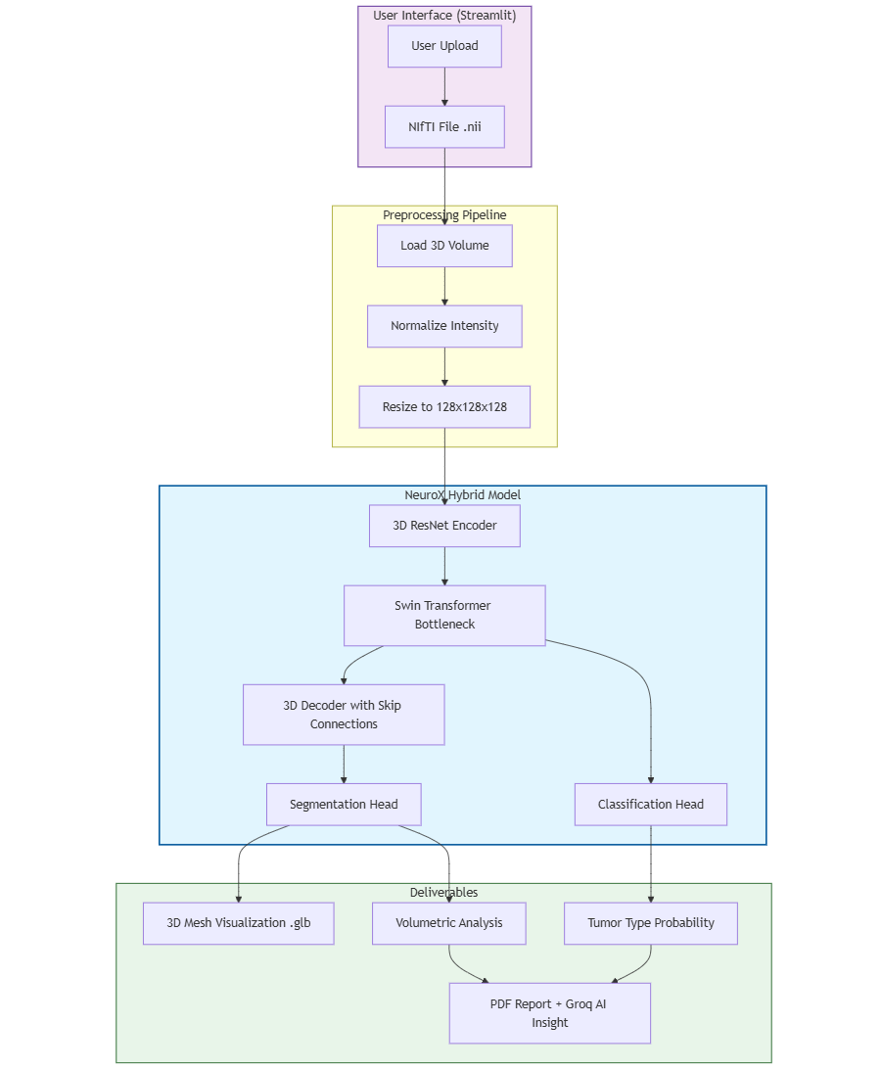
System Workflow
Workflow Steps:
User Input: Upload .nii or .nii.gz file via Streamlit UI.
Preprocessing:
Load 3D Volume.
Normalize Intensity (0-1 scale).
Resize to ROI (128, 128, 128).
NeuroX Inference: The Hybrid model processes the data.
Deliverables: 3D GLB Mesh generation + PDF Report creation.

Slide 10
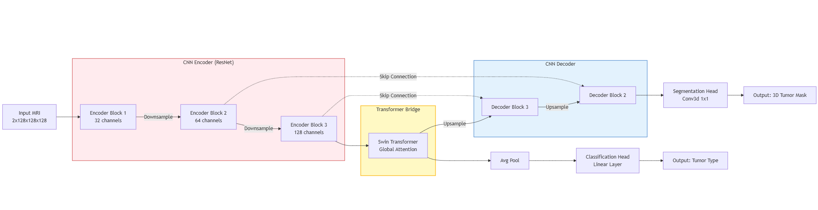
Proposed Architecture (Technical Core)
Encoder (Pink): Uses ResBlock3D to downsample features.
Transformer Bridge (Yellow): The key innovation. A SwinBlock3D processes the latent features with self-attention.
Dual Heads (Purple):
Segmentation: Outputting a 3D mask.
Classification: Outputting disease probability.

Slide 11
Feasibility – The Encoder
Component: ResBlock3D (Residual Block).
Function: Extracts features using 3D Convolutions (nn.Conv3d) and Group Normalization (nn.GroupNorm).
Feasibility Check: We limit the channel depth to 32 → 64 → 128 filters. This ensures the model fits within the VRAM of standard GPUs (e.g., T4 or RTX 3060).

Slide 12
Feasibility – The Transformer Bridge
Component: SwinBlock3D.
Mechanism: Uses nn.MultiheadAttention to analyze relationships between features.
Optimization: Instead of standard attention (which is $O(N^2)$), we use window-based attention to reduce computational complexity, making 3D processing feasible.

Slide 13
Assumptions & Constraints
Assumptions:
Input Format: Data must be in NIfTI format (standard for medical research).
Modality: Scans must contain at least two channels (e.g., FLAIR + T1ce) for accurate feature extraction.
Constraints:
Resolution: Input is strictly cropped/resized to (128, 128, 128) to prevent Memory OOM errors.
Scope: Model detects only Glioma, Meningioma, and Pituitary tumors; it is not a general-purpose brain anomaly detector.

Slide 14
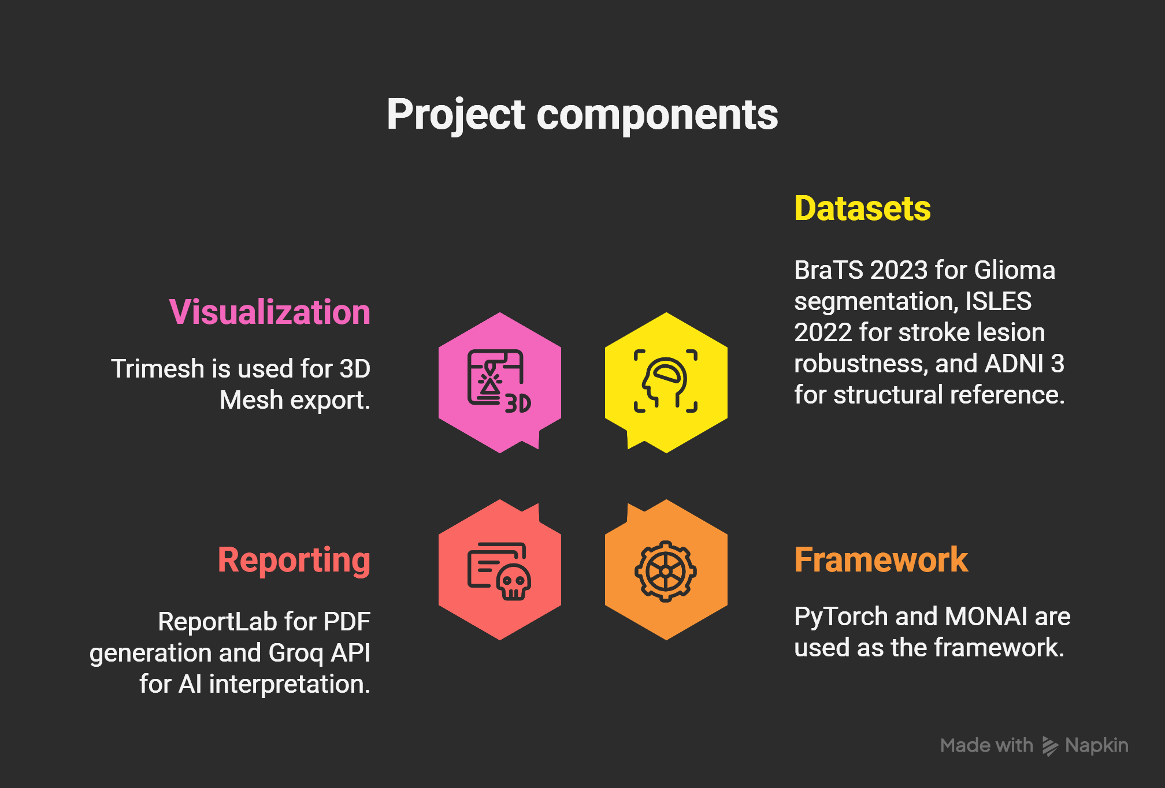
Implementation Plan

Slide 15
Conclusion & Future Work
Summary: NeuroX Hybrid addresses the limitations of standard CNNs by integrating Transformers for better context.
Status: Architecture is defined, datasets are identified, and the feasibility of 3D processing is confirmed via the 128^3 constraint.
Next Phase: We will proceed to training the Encoder-Decoder on the BraTS dataset and developing the Streamlit frontend.

